Slide 1
Threat management for wetland
Threats
Concept and information about them
Ph.D. Emirjeta Adhami

Slide 2
Content of session
Concept of threats in wetland
Why they are threats?
Main threats in wetlands
Why should they be managed?

Slide 3
Under the Ramsar international wetland conservation treaty, wetlands are defined as:
"...areas of marsh, fen, peatland or water, whether natural or artificial, permanent or temporary, with water that is static or flowing, fresh, brackish or salt, including areas of marine water the depth of which at low tide does not exceed six metres."

Slide 4
Ramsar wetland type Marine/Coastal
Permanent shallow marine waters less than six metres deep at low tide; includes sea bays and straits
Marine subtidal aquatic beds; includes kelp beds, sea-grass beds, tropical marine meadows
Coral reefs.
Rocky marine shores; includes rocky offshore islands, sea cliffs.
Sand, shingle or pebble shores; includes sand bars, spits and sandy islets; includes dune systems.
Estuarine waters; permanent water of estuaries and estuarine systems of deltas.
Intertidal mud, sand or salt flats.
Intertidal marshes; includes salt marshes, salt meadows, saltings, raised salt marshes; includes tidal brackish and freshwater marshes.
Intertidal forested wetlands; includes mangrove swamps, nipah swamps and tidal freshwater swamp forests.
Coastal brackish/saline lagoons; brackish to saline lagoons with at least one relatively narrow connection to the sea.
Coastal freshwater lagoons; includes freshwater delta lagoons.

Slide 5
Ramsar wetland type Inland Wetlands
L. Permanent inland deltas. M. Permanent rivers/streams/creeks; includes waterfalls. N. Seasonal/intermittent/irregular rivers/streams/creeks. O. Permanent freshwater lakes (over 8 ha); includes large oxbow lakes. P. Seasonal/intermittent freshwater lakes (over 8 ha); includes floodplain lakes. Q. Permanent saline/brackish/alkaline lakes. R. Seasonal/intermittent saline/brackish/alkaline lakes and flats.* Sp. Permanent saline/brackish/alkaline marshes/pools. Ss. Seasonal/intermittent saline/brackish/alkaline marshes/ pools.* Tp. Permanent freshwater marshes/pools; ponds (below 8 ha), marshes and swamps on inorganic soils; with emergent vegetation water-logged for at least most of the growing season.

Slide 6
Ramsar wetland type Inland Wetlands
Ts. Seasonal/intermittent freshwater marshes/pools on inorganic soil; includes sloughs, potholes, seasonally flooded meadows, sedge marshes. U. Non-forested peatlands; includes shrub or open bogs, swamps, fens. Va. Alpine wetlands; includes alpine meadows, temporary waters from snowmelt. Vt. Tundra wetlands; includes tundra pools, temporary waters from snowmelt. W. Shrub-dominated wetlands; Shrub swamps, shrub-dominated freshwater marsh, shrub carr, alder thicket; on inorganic soils. Xf. Freshwater, tree-dominated wetlands; includes freshwater swamp forest, seasonally flooded forest, wooded swamps; on inorganic soils. Xp. Forested peatlands; peatswamp forest. Y. Freshwater springs; oases. Zg. Geothermal wetlands. Zk. Subterranean karst and cave hydrological systems.

Slide 7
Ramsar wetland type "Man-made" wetlands
Aquaculture (e.g. fish/shrimp) ponds.
Ponds; includes farm ponds, stock ponds, small tanks; (generally below 8 ha).
Irrigated land; includes irrigation channels and rice fields.
Seasonally flooded agricultural land.
Salt exploitation sites; salt pans, salines, etc.
Water storage areas; reservoirs/barrages/dams/impoundments; (generally over 8 ha)
Excavations; gravel/brick/clay pits; borrow pits, mining pools.
Wastewater treatment areas; sewage farms, settling ponds, oxidation basins, etc.
Canals and drainage channels, ditches.

Slide 8
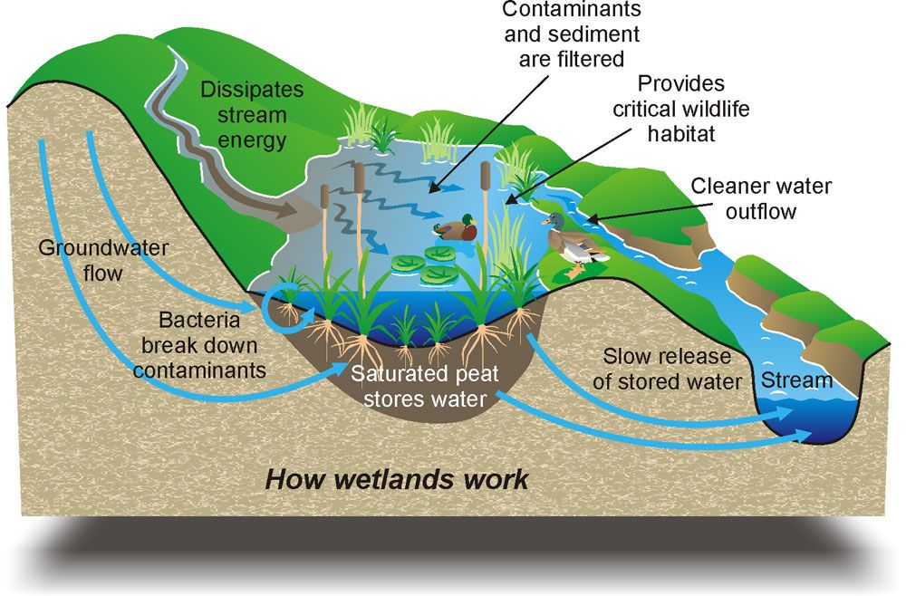
Wetland performs numerous valuable function such as recycle nutrients, purify water, attenuate floods, recharge ground water and also serves in providing drinking water, fish, fodder, fuels, wildlife habitat, control rate of runoff in urban areas, buffer shorelines against erosion and recreation to society. Due to anthropogenic activities and urbanization they have been declining at an alarming rate.

Slide 9
But they face with different threats…….
…make changes, damages or destroy them…

Slide 10
Concept of threats
An activity or process that has caused, is causing or may cause the destruction, degradation and/or impairment of biodiversity and natural processes.

Slide 12
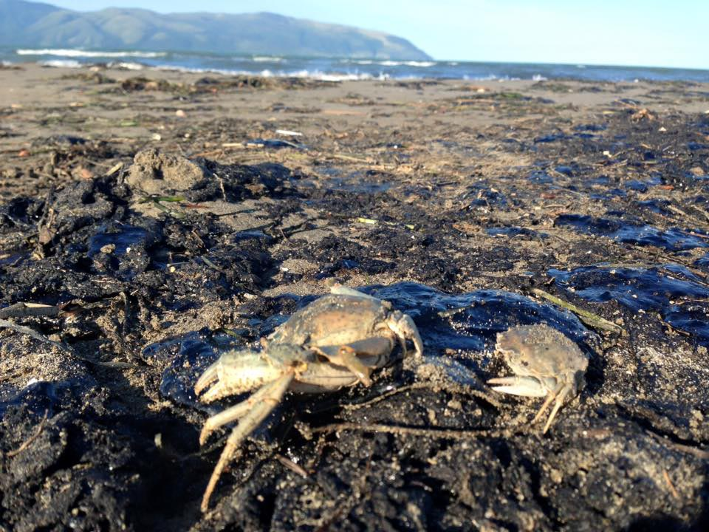
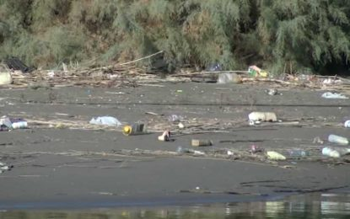
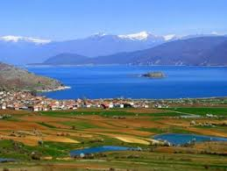
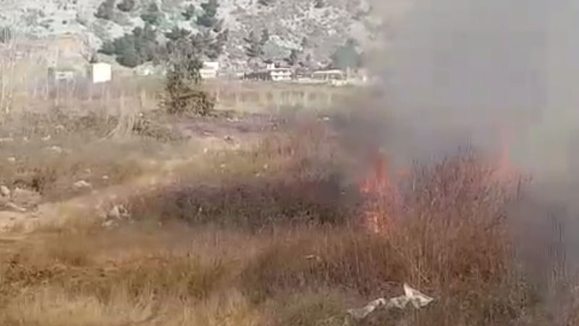
Types of threats - pollutions
Industrial
Agricultural
urban wastewater
air pollution

Slide 13
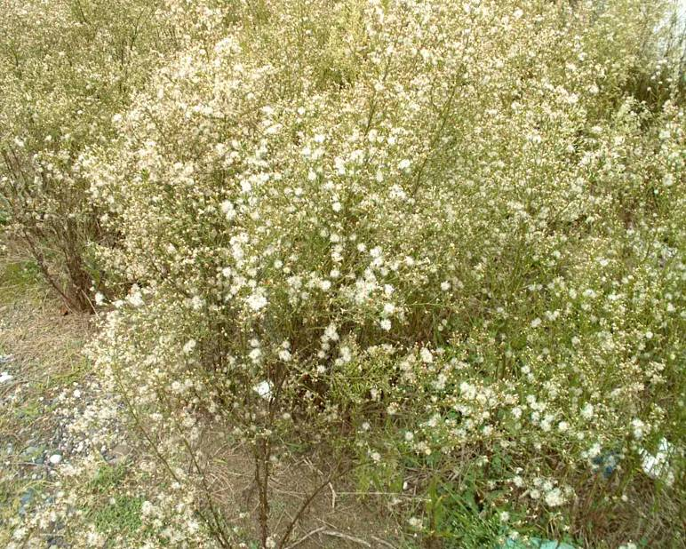
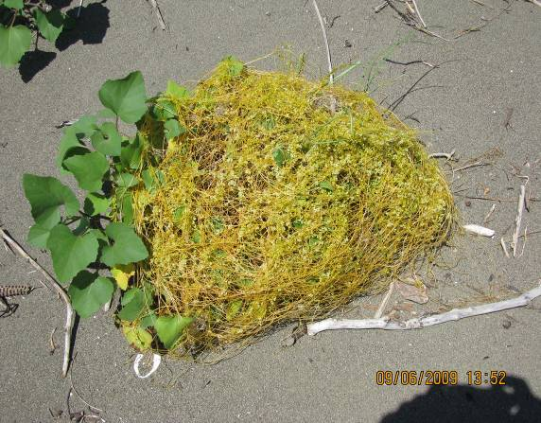
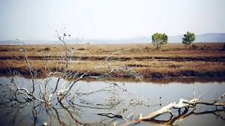
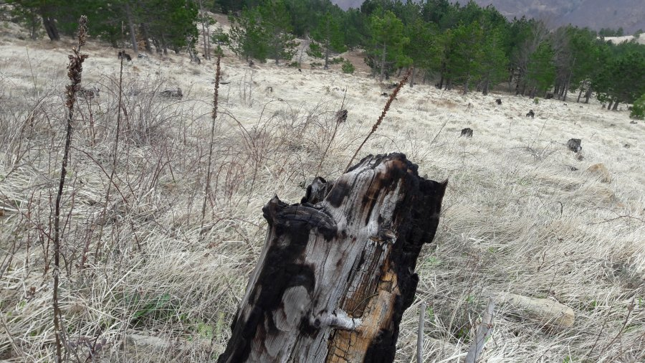
Types of threats - loss of vegetation
Introduction of invasive species
Loss of green landscape

Slide 14
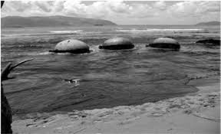
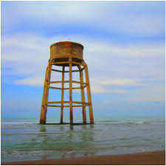
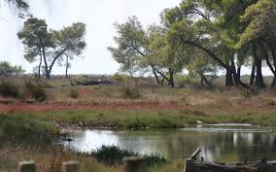
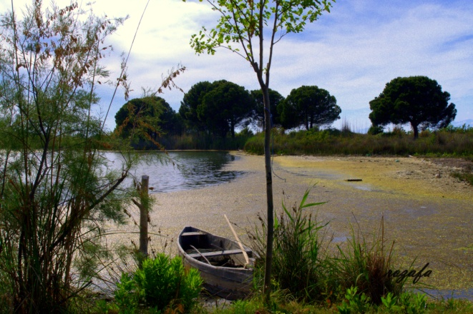
Types of threats - climate change impacts
Sea level rise
Temperature increase
Decrease precipitation

Slide 15
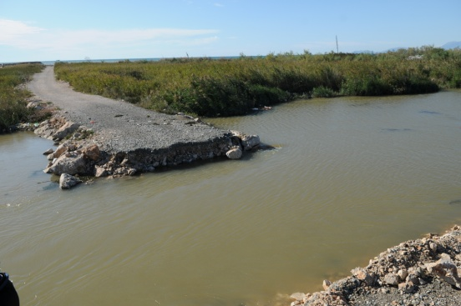
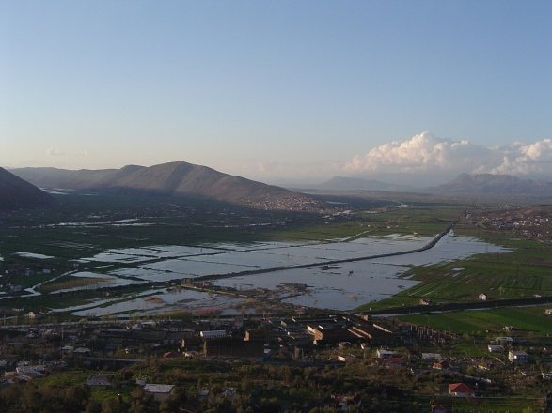
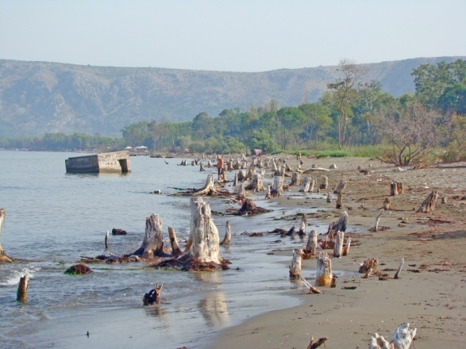
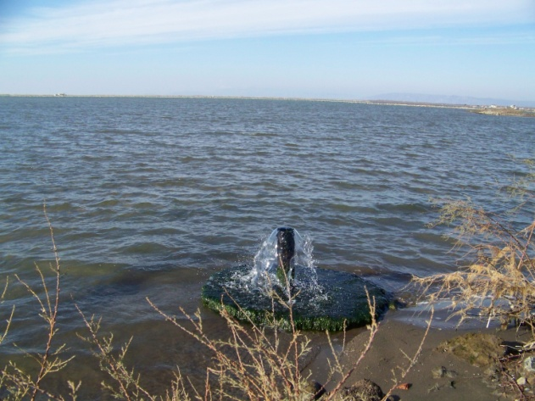
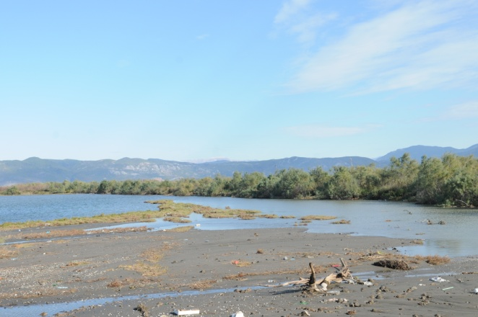
Types of threats - water regime
alteration of natural regimes,
construction dams and weirs,
inundation,
surface water erosion and sedimentation,
waterlogging,
water and groundwater extraction

Slide 16
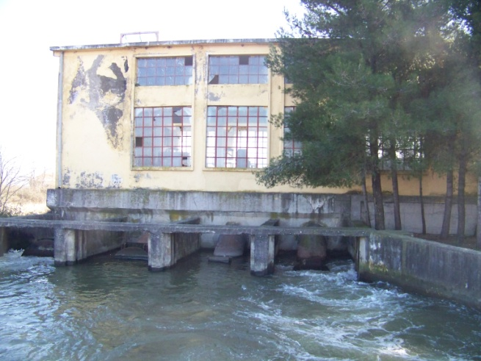
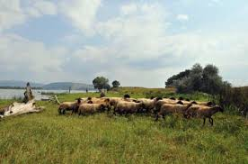
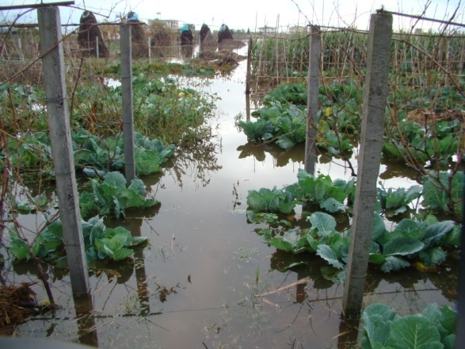
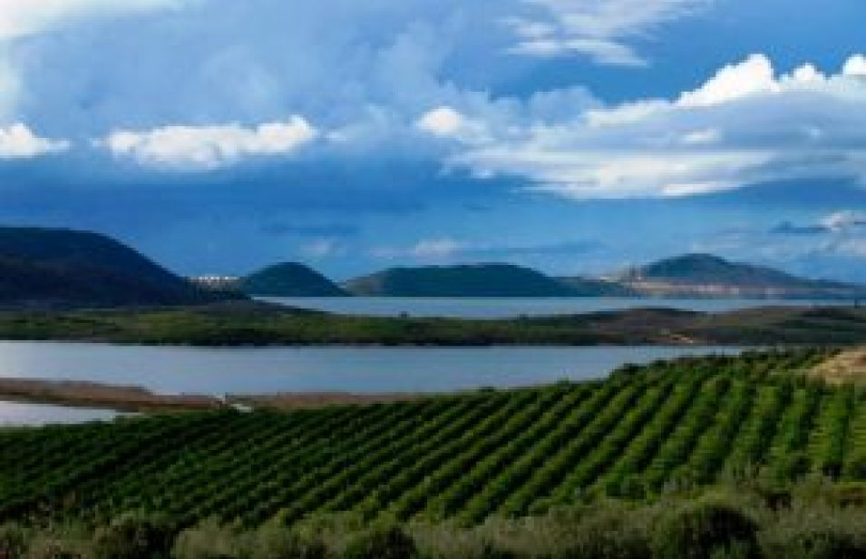
Types of threats - artificial drainage and agricultural processes

Slide 17
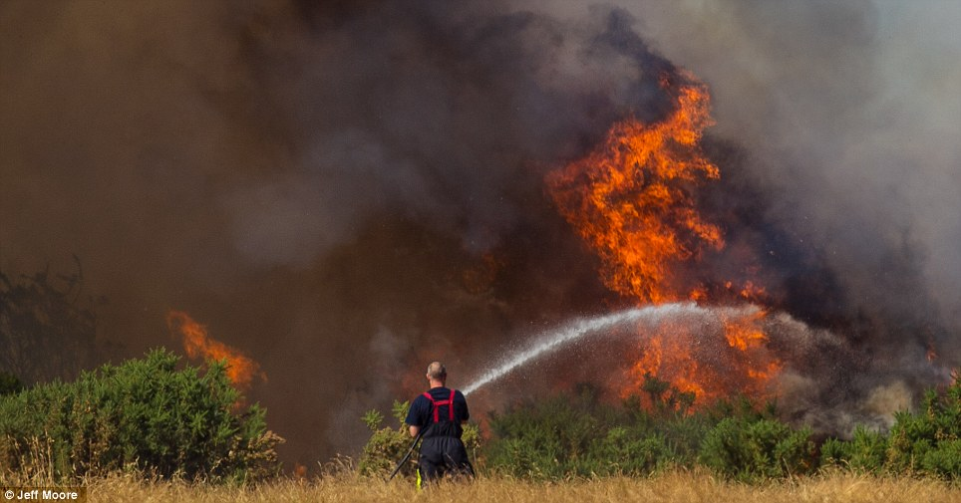
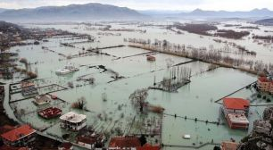
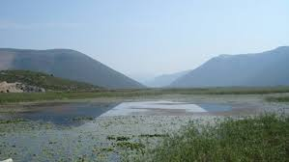
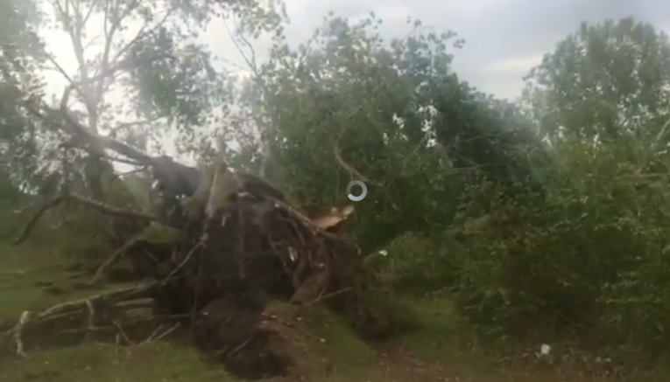
Types of threats - natural processes
fire,
floods,
cyclones,
drought

Slide 18
How do threats impacts wetlands?
Habitat Loss
The destruction, degradation, and fragmentation of natural habitats -- our forests, wetlands, and grasslands -- pose the greatest threat to the nation's thousands of different plants and animals.
Development Pressure
While many human activities can alter natural habitats, the conversion of green space to urban and suburban uses is the fastest growing threat to the nation's plants, animals, and open spaces.

Slide 19
How do threats impacts wetlands?
Pollution Is Killing The Flora And Fauna Of Wetlands
wetlands are treated as the dumping grounds where industrial effluents, household wastes or sewage is released. High pollution rates in such wetlands kill off the flora and fauna and thus destroy the wetland habitat.
Climate Change Is Destroying Wetland Habitats
In places where the temperature increase is raising the sea levels, the coastal wetlands are being submerged or drowned. In other places where higher temperatures are triggering droughts, the wetlands are also drying out. Thus, wetlands are getting lost both due to higher and lower water levels induced by the varying effects of climate change in different parts of the world.

Slide 20
How do threats impacts wetlands?
Construction of Dams alter the Flow of Water to Wetlands
Dams alter the natural flow of a river to meet human needs. Wetland areas like swamps, marshes, etc., might suffer from a lower or a higher flow of water than normal due to the construction of dams. Thus, dams have the power to permanently damage the wetland ecosystems.

Slide 21
Threats should be managed
Wetlands are among the rarest and most threatened ecosystems on the planet. They are also of the most important ones as the habitat for unique and endangered species and are vital for human life. The loss and degradation of wetlands reduce their ability to provide goods and services for humankind and to support biodiversity. They are therefore associated with economic costs and considered as a threat to human life on earth.
It is a responsibility of individuals from states, international organizations, governors, politicians, scientists and academics - on national and international level, to stand up for the right of present and future generations and by cooperation and contribution through:
1. Adopting a strategic approach to site management including ecosystem-based approach;
2. Establishing programs to monitor change in ecological character; and
3. Publishing and disseminate the information from inventory and monitoring programs to raise awareness.
The Ramsar Convention was established to address the issue of the loss and degradation of wetlands through concerted and coordinated action by the Contracting Parties, so that wetlands can contribute to the process of sustainable development. The Ramsar Convention has succeeded in raising awareness and the level of actions for conservation of wetlands; yet wetlands continue to be lost and degraded at a rapid pace in many parts of the world due to selfish over-exploitation of wetlands and their natural resources.

Slide 22
Questions and Answers!

